Slide 1

Video Game Sales
Deepak R
9th April 2024

Slide 2

Table of
CONTENTS
01
02
03
04
Objective
Data Sources
Historical Sales Analysis
Year and Region wise Trend Analysis
05
06
07
08
Brand and Genre Popularity
Dashboard
Recommendations
Summary

Slide 3

Objective 1
Proposed
Analysing the current growth of video games across different regions.
OBJECTIVES
Objective 2
Analysing the brand and genre popularity across regions.
Objective 3
Recommending an adequate solution based on the insights derived from the historical data analysis.

Slide 4



THE DATA
Dataset :
Video Game Sales public dataset from Kaggle by the author GregorySmith - https://www.kaggle.com/datasets/gregorut/videogamesales/data
Data Integrity and Reliability :
Rigorous validation processes, including data cleansing, normalization, and validation against multiple sources, are employed to minimize errors and biases.

Slide 5


Historical Sales
ANALYSIS
Analysis on video games sales growth over the years needs to be done.
Brand and Genre popularity across different regions needs to be identified.
Recommendations to be provided based on the insights derived from the historical data analysis.

Slide 6
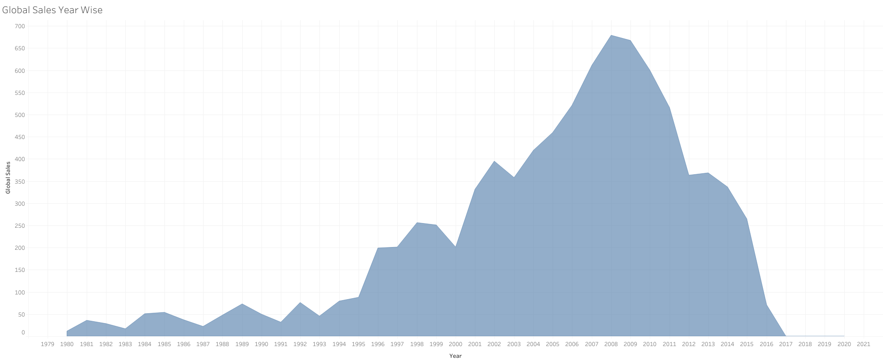
Yearly Trend Analysis
A sharp demand is observed throughout from 1993 to 2008 which is followed by a sharp decline.
The reason for the decline needs to be analysed by taking into account other factory.
Avoided the years from 2017 - 2022 because of Covid outbreak

Slide 7
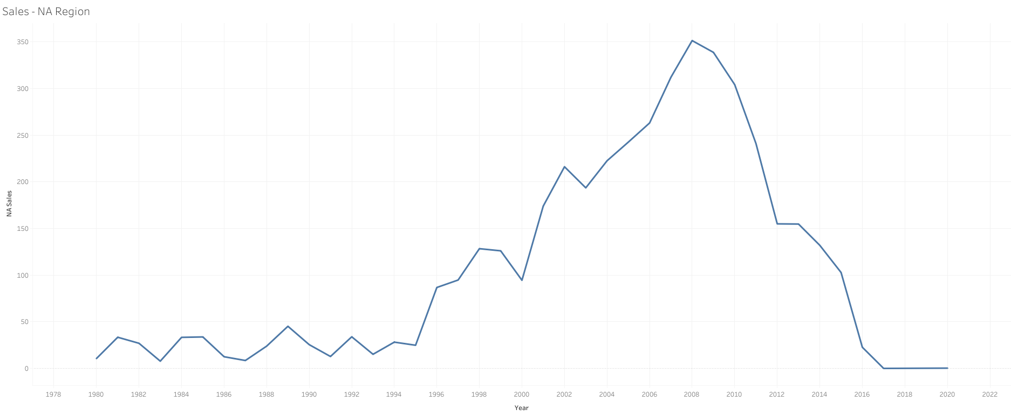
Yearly Trend Analysis - NA region

Slide 8
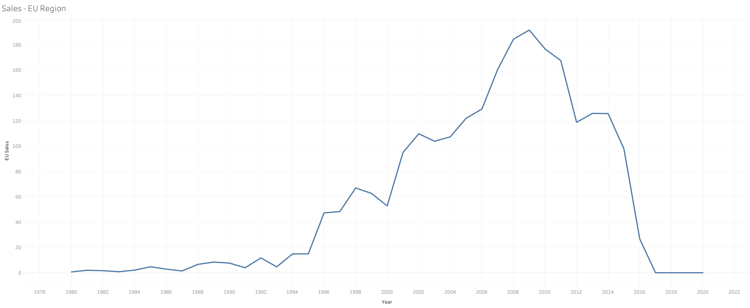
Yearly Trend Analysis - EU region

Slide 9
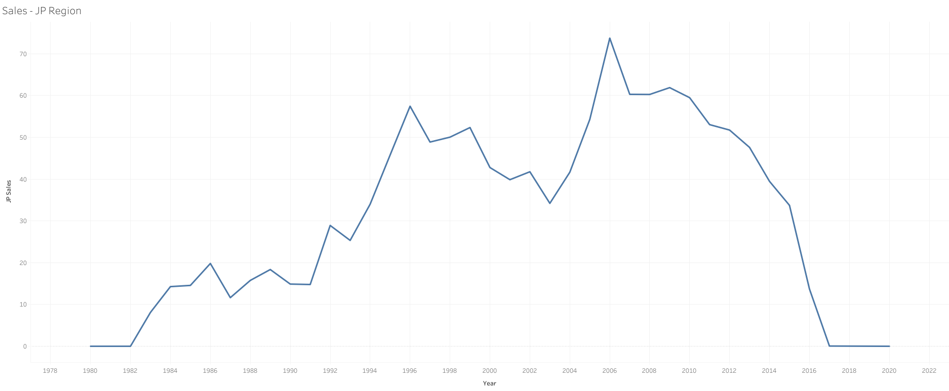
Yearly Trend Analysis - JP region

Slide 10
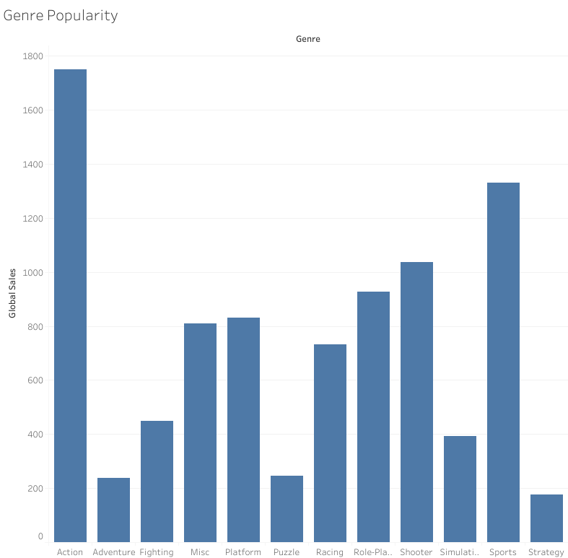
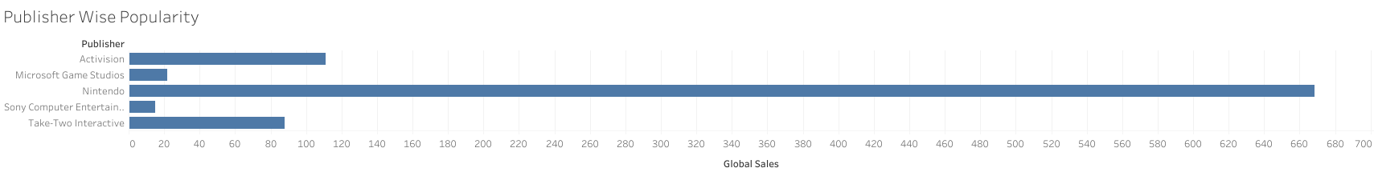
Brand and Genre Popularity
It is observed that that the genres - Action, Sports and shooting are preferred more than the other genres with each accounting to more than 1000 million dollar global sales.
When considering publisher wise, We could observe that games released by Nintendo, Activision and Take-Two Interactives gain wide popularity.

Slide 11
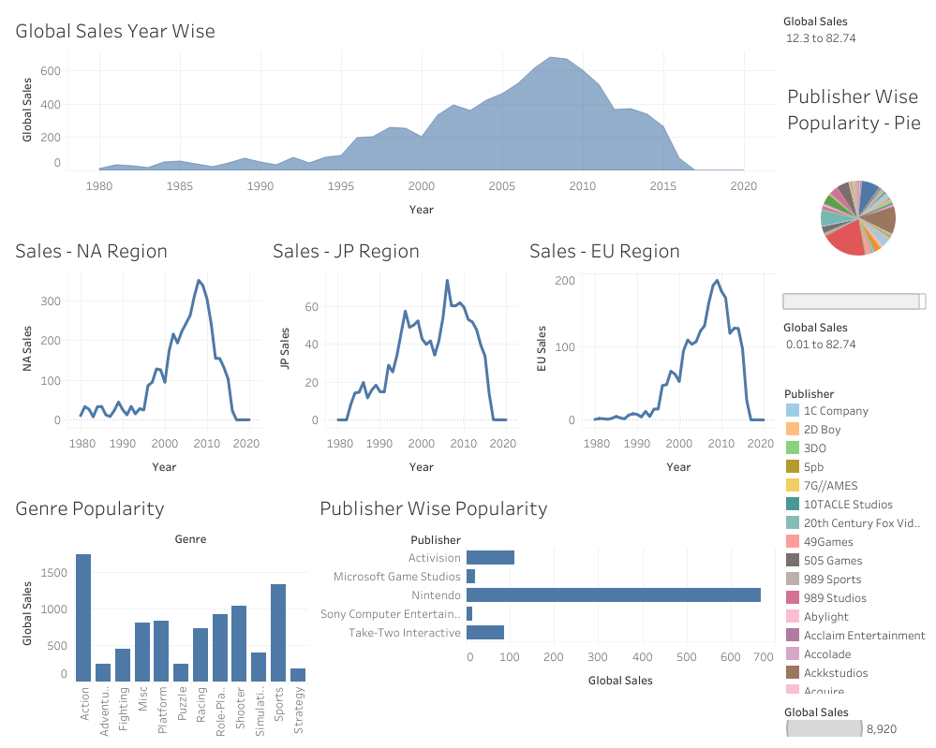
Dashboard

Slide 12
Recommendations
As per my analysis, We could expect a big sales for Action, Sports or Shooting games released by Nintendo in the upcoming years.

Slide 13
Summary
When analysed the growth over JP region , we could observe that there was a gradual decline in sales over the years from 1996-2003 even when the sales was growing for the rest of the regions. Factors which leads to this downfall needs to be analysed further.
The sales figure has reached its peak revenue by the year 2008-2009 and a steep decline is observed later on. It could be because of a shift in gaming alternatives and needs to be investigated further.

